Slide 1
Data Management for Analytics
By Prof. Jim Ryan
Adhiraj Budukh

Slide 2
Index
Dataset Description
Data preparation and Data Wrangling
Data Mining and its Outcomes
Data Visualisation and its Outcomes
Notes:
This PowerPoint Template includes a series of slide masters with predefined layouts and color schemes for formatting slides
Slide Masters are displayed when you right click on a slide and select Layout from menu

Slide 3
Dataset Description
Dataset 1
Movie Id
Original Language
Title
Popularity
Release Date
Voting Average
Genre
Revenue
Dataset 2
Movie Id
Title
User Id
Movie rating by User
Gender
Genre
Age

Slide 4
Dataset Description
Data merging for Dataset2:
Merged 3 csv files using python code over the common columns of the dataset
This merged dataset has 1 million of rows

Slide 5
Dataset Description : quality/integrity/ethics
The larger dataset has one to many relationship between the columns like : single movie with its genre and id (1->many) rating, age, gender i.e.one movie was rated by multiple users of any gender and different ratings
Incomplete Genre Data: The 'genres' column has only 6020 non-null values out of a total of 1000209 rows. This means that genre information is missing for a large portion of the movies in the dataset. This could limit the usefulness of the dataset for certain types of analysis or recommendations.
Biased User Demographics: The dataset only includes information on gender and age of the users, and it is not clear how representative the sample is of the general population. The dataset is not be inclusive of all types of users, which could lead to biased recommendations or conclusions based on the data.
Limited Rating Scale: The rating column only ranges from 1 to 5, which could limit the granularity of the analysis and recommendations that can be made from the data.
Potential for Fraudulent Ratings: There is no information on how the ratings were obtained from the users, which could leave the dataset open to potential fraudulent ratings or other data quality issues.

Slide 6
Dataset Description : Quality/Integrity/Ethics
Privacy Concerns: The dataset contains personal information such as gender and age, which could raise privacy concerns if the data is not handled appropriately.
Lack of Contextual Information: The dataset does not provide any contextual information about the movies, such as release date or production budget, which could limit the analysis and insights that can be drawn from the data.
While in the smaller data there are missing values: There are missing values in almost all columns, with the number of non-null values ranging from 5336 to 10014. This can be problematic for data analysis since missing data can bias results and decrease the representativeness of the dataset.Inconsistent data types: Some columns contain data of inconsistent data types. For example, The "release_date" column is also of type "object" while it will be more appropriate to represent it as a datetime object.

Slide 7
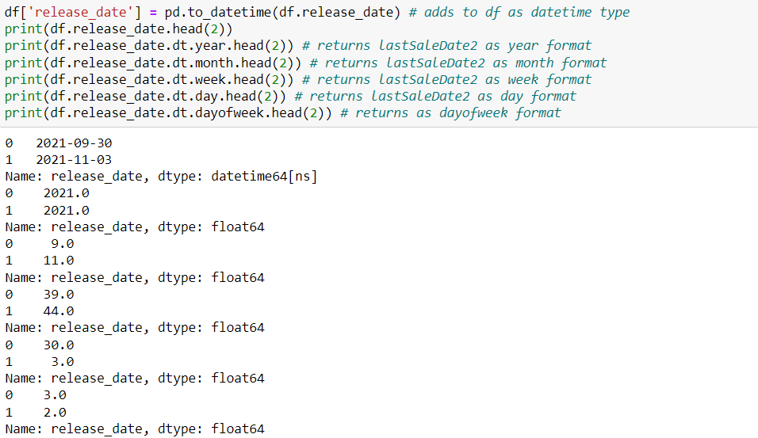
Data Wrangling Operations Outcomes

Slide 8
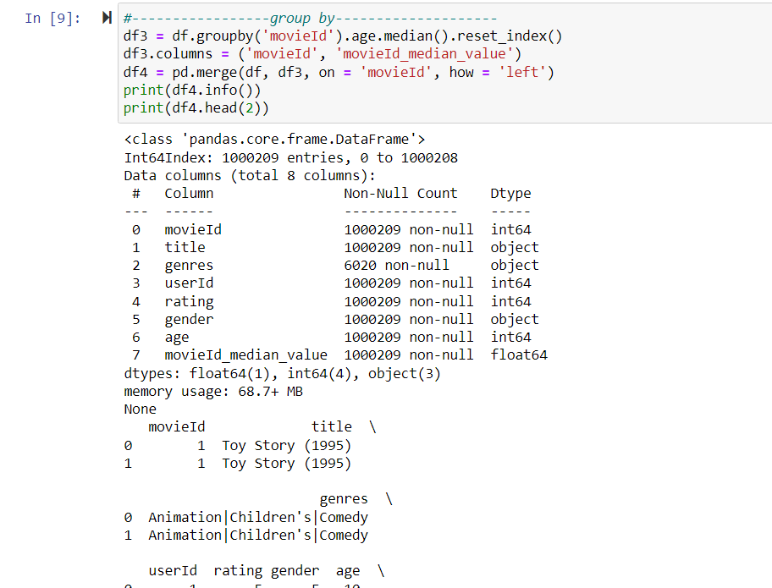
Data Wrangling Operations Outcomes

Slide 9
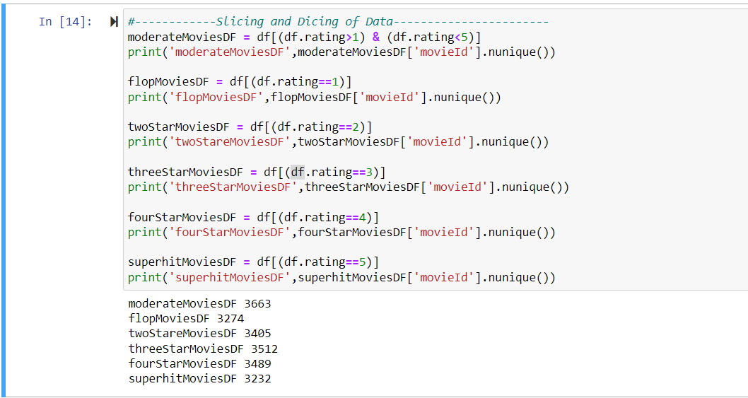
Data Wrangling Operations Outcomes

Slide 10
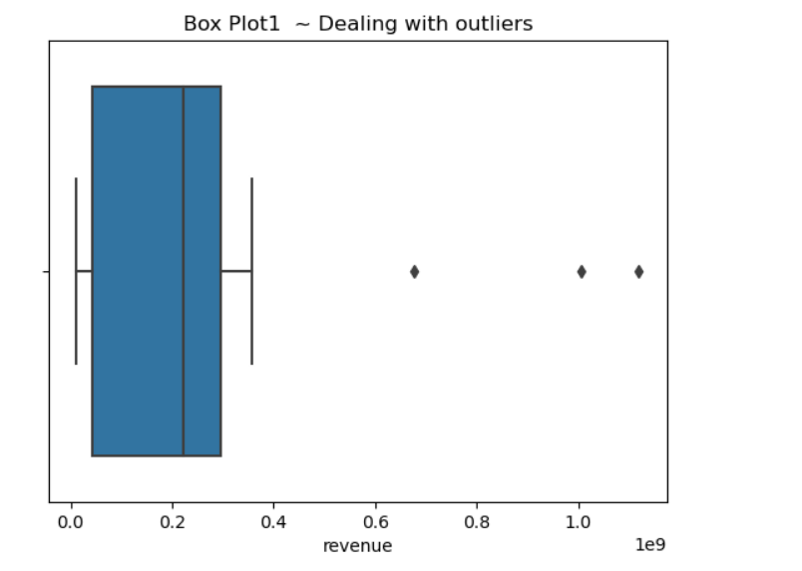
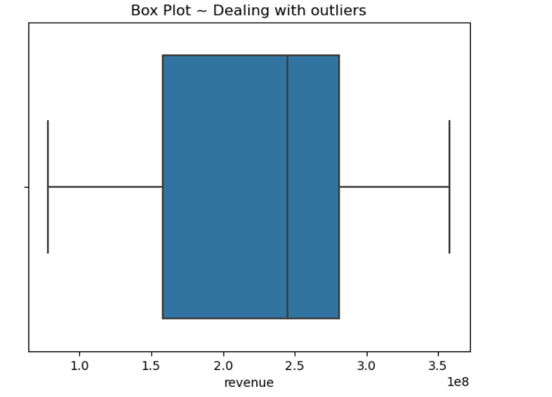
Data Wrangling Operations Outcomes

Slide 11
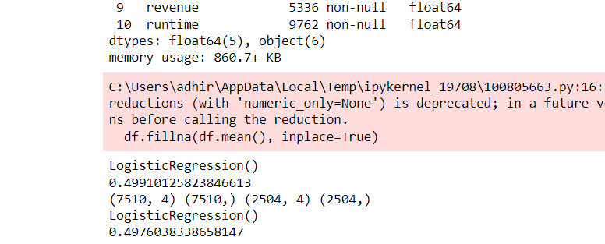
Data Mining Operations Outcomes
#Logistic Regression
As we can see it has only 49% score so Logistic regression model has an accuracy score of around 50%, which means it is not a good model for predicting gender based on movie ratings, vote counts, revenue, and runtime. It also shows that splitting the dataset into training and testing sets did not improve the accuracy of the model.
Notes:
BEST PRACTICES:
Open Excel 2007 before creating charts in PowerPoint
Duplicate this slide and edit data

Slide 12
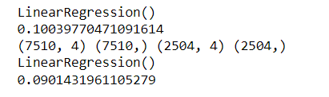
Data Mining Operations Outcomes
#Linear Regression
As we can see Linear regression has 9% score only and the model may not capture the relationship between the features and the target variable accurately hence its not good method to use for our dataset
Notes:
BEST PRACTICES:
Open Excel 2007 before creating charts in PowerPoint
Duplicate this slide and edit data

Slide 13
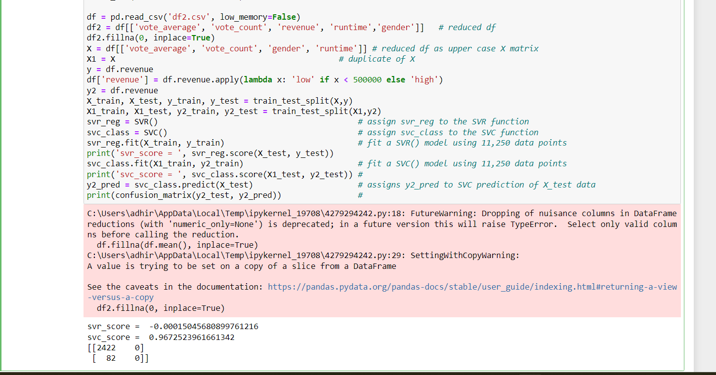
Data Mining Operations Outcomes
Support Vector Machine
As we can see the SVR model performs poorly with a negative R-squared score, which indicates that the model does not fit the data well. On the other hand, the SVC model performs well with an accuracy score of approximately 97%. However, when looking at the confusion matrix, we can see that the model is predicting only the low revenue category, with all the high revenue movies being classified as low revenue. Hence not good fit for the dataset
Notes:
BEST PRACTICES:
Open Excel 2007 before creating charts in PowerPoint
Duplicate this slide and edit data

Slide 14
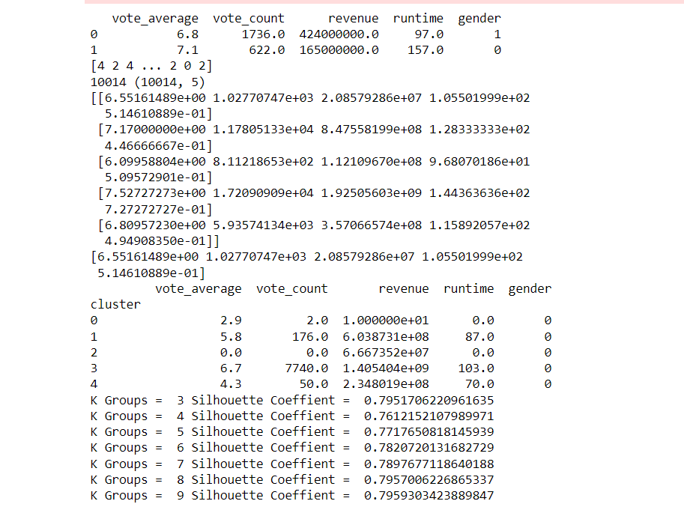
Data Mining Operations Outcomes
K Means Clustering : Result indicates that the Silhouette Coefficient for 9 clusters is 0.7959, which is quite high and suggests that the clustering can be well-defined and the movies are grouped together in a meaningful way based on their features. This could be useful for further analysis or for making recommendations based on the features of the movies in each cluster.
Notes:
BEST PRACTICES:
Open Excel 2007 before creating charts in PowerPoint
Duplicate this slide and edit data

Slide 15
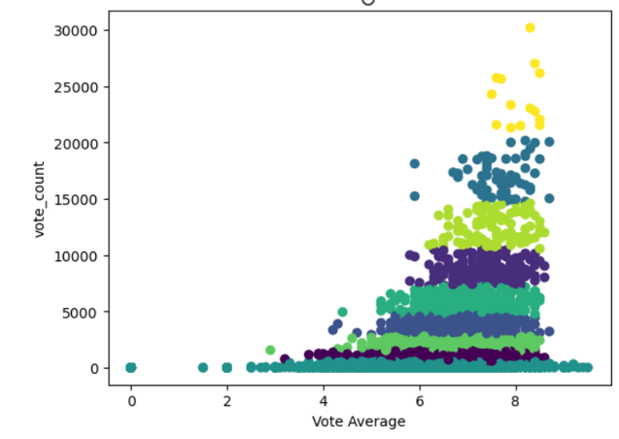
Data Mining Operations Outcomes
Here is one example of clustering with k=9
Notes:
BEST PRACTICES:
Open Excel 2007 before creating charts in PowerPoint
Duplicate this slide and edit data

Slide 16
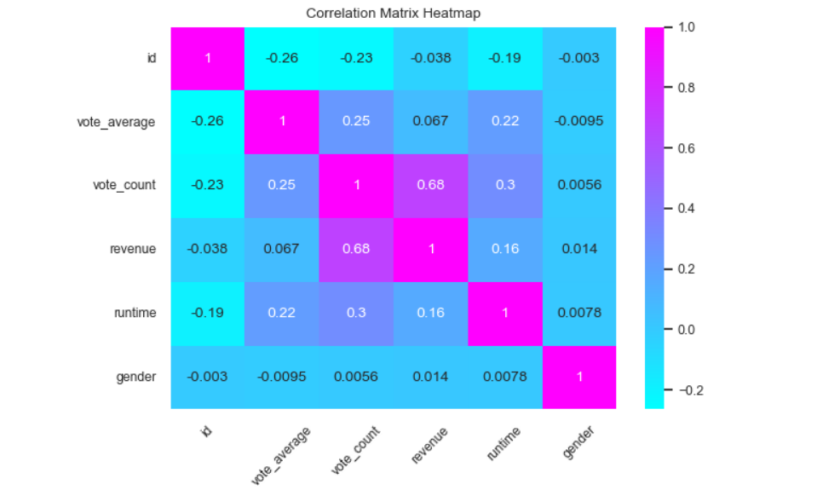
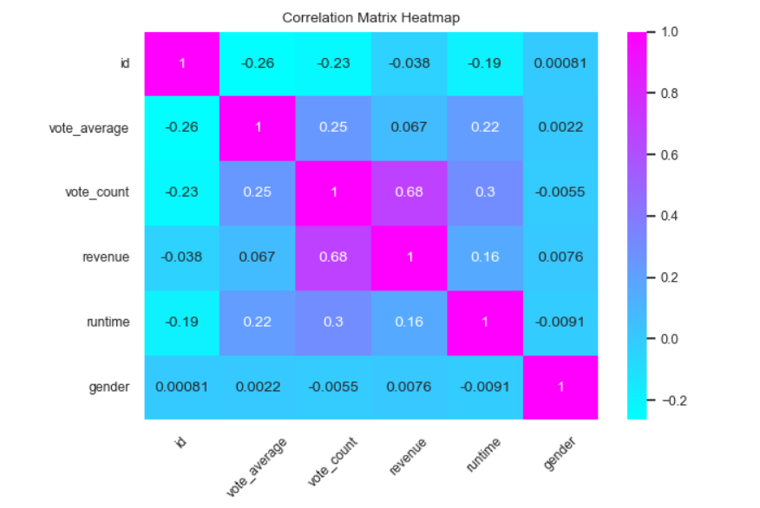
Data Mining Operations Outcomes
Before
After
Notes:
BEST PRACTICES:
Open Excel 2007 before creating charts in PowerPoint
Duplicate this slide and edit data

Slide 17
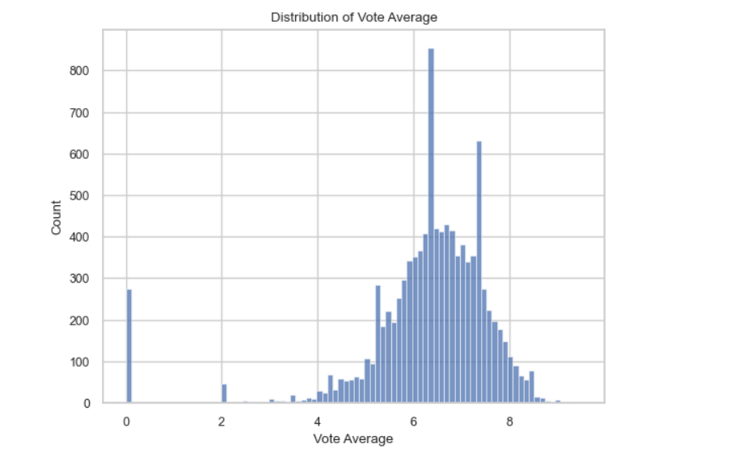
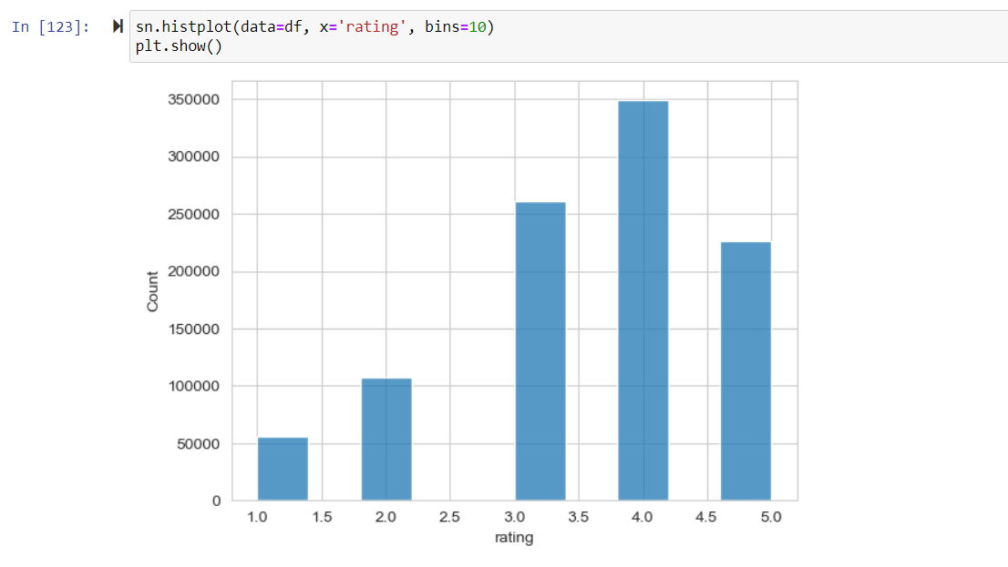
Data Visualization Outcomes
Notes:
BEST PRACTICES:
Open Excel 2007 before creating charts in PowerPoint
Duplicate this slide and edit data

Slide 18
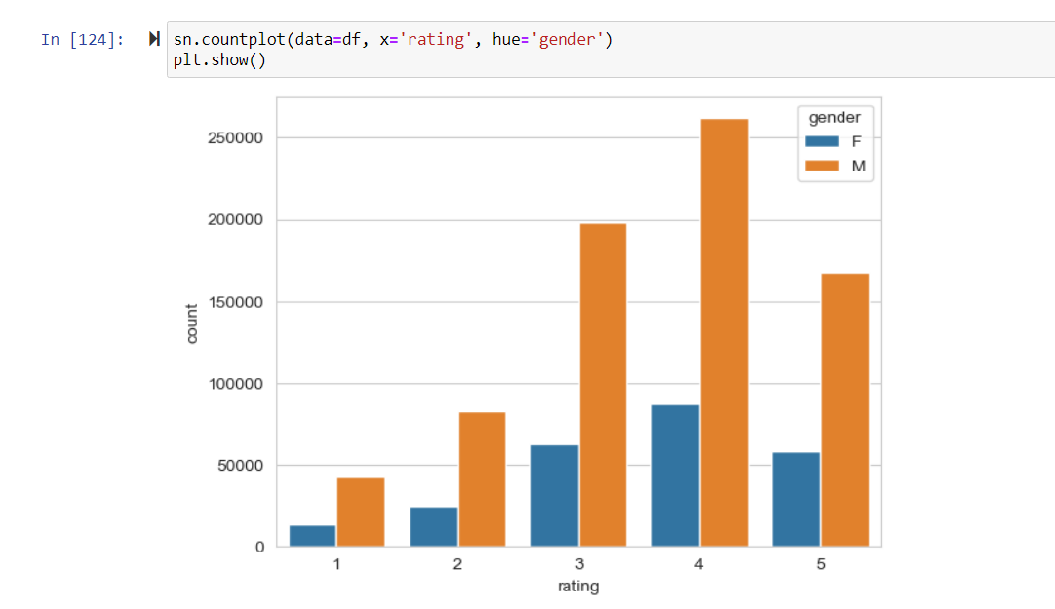
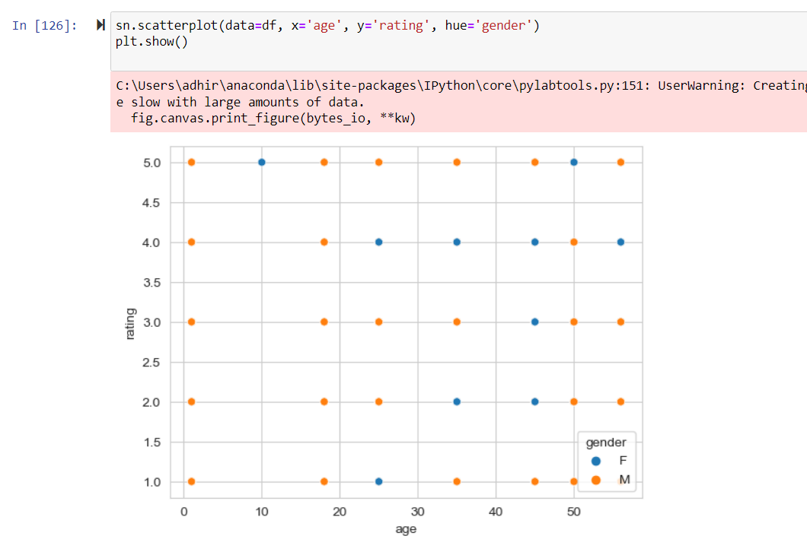
Data Visualization Outcomes
Notes:
BEST PRACTICES:
Open Excel 2007 before creating charts in PowerPoint
Duplicate this slide and edit data

Slide 19
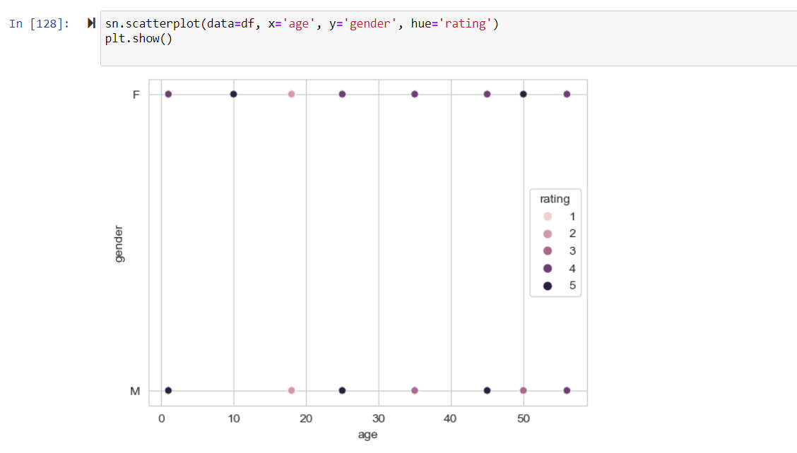
Data Visualization Outcomes
Notes:
BEST PRACTICES:
Open Excel 2007 before creating charts in PowerPoint
Duplicate this slide and edit data

Slide 20
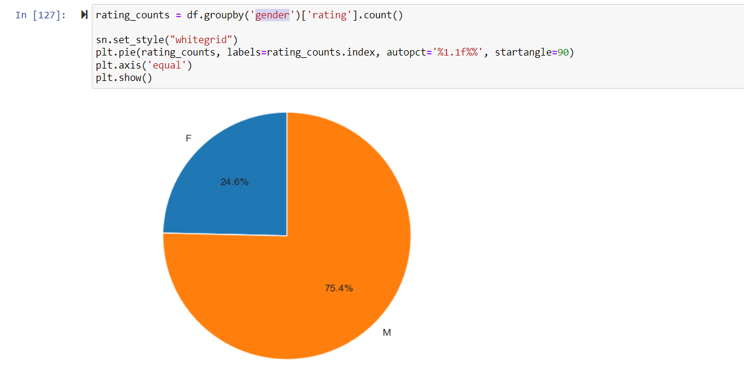
Data Visualization Outcomes
Notes:
BEST PRACTICES:
Open Excel 2007 before creating charts in PowerPoint
Duplicate this slide and edit data

Slide 21
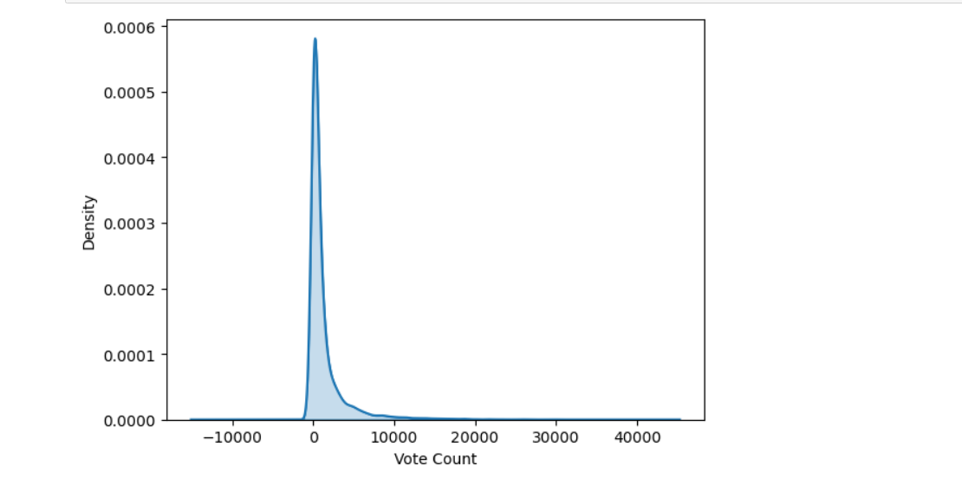
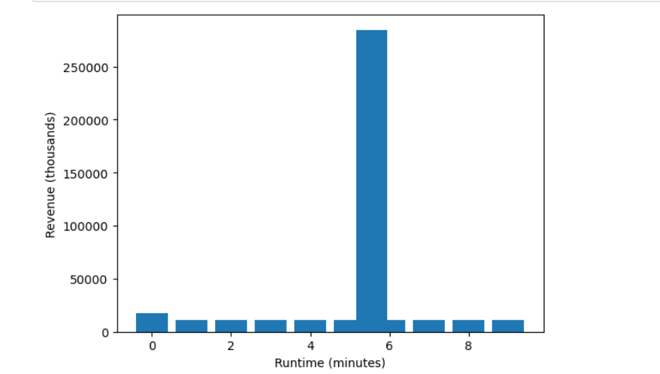
Data Visualization Outcomes
Notes:
BEST PRACTICES:
Open Excel 2007 before creating charts in PowerPoint
Duplicate this slide and edit data

Slide 22
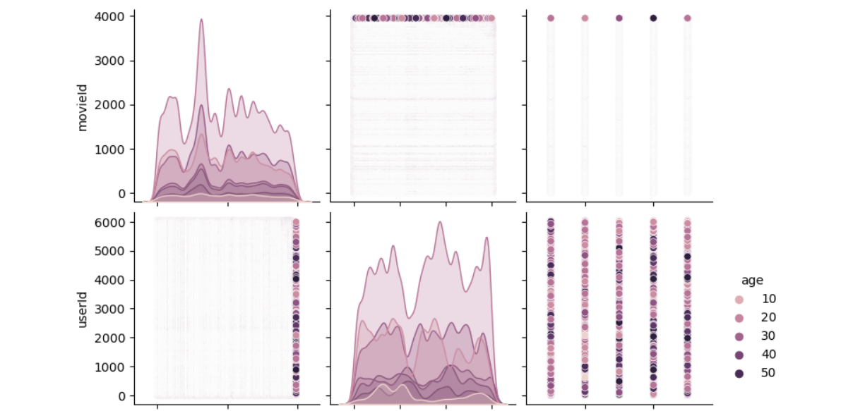
Data Visualization Outcomes
Notes:
BEST PRACTICES:
Open Excel 2007 before creating charts in PowerPoint
Duplicate this slide and edit data

Slide 23
Summary : Future Scope, Limitations
Conclusion :
Among the applied techniques on datasets, we can conclude that K means Clustering analysis technique is good fit for our dataset.
Based on the different parameter we can use similar types of data to build recommendation system in OTT platforms to recommend movies.
Limitations:
The numerical data was very less in the dataset so performing relevant operations
where numerical data is required had to perform in the limited data.

Slide 24
Thank You !!!

